Slide 1
History and Evolution of Dracula
Alex Iacob
Professor Bucciferro
COMM 304 - Intercultural Communication

Slide 2
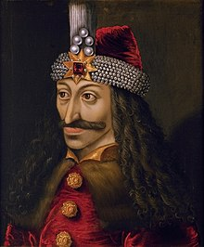
Who was Dracula?
The portrayal of Dracula is based off of a real person, named Vlad III Dracula. He was born in Sighisoara, Transylvania in 1431 to the house of Draculesti as the second son of Vlad Dracul.

Slide 3
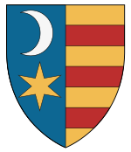
Royalty
The House of Drăculești
The Princely Noble Family
Pronounced “Druh-Coo-Lesh-Ti”
The House of Drăculești was one of two major lines of the House of Basarab. The other being the House of Dănești. These two houses fought for the throne of Wallachia throughout the late 14th and early 16th centuries.

Slide 4
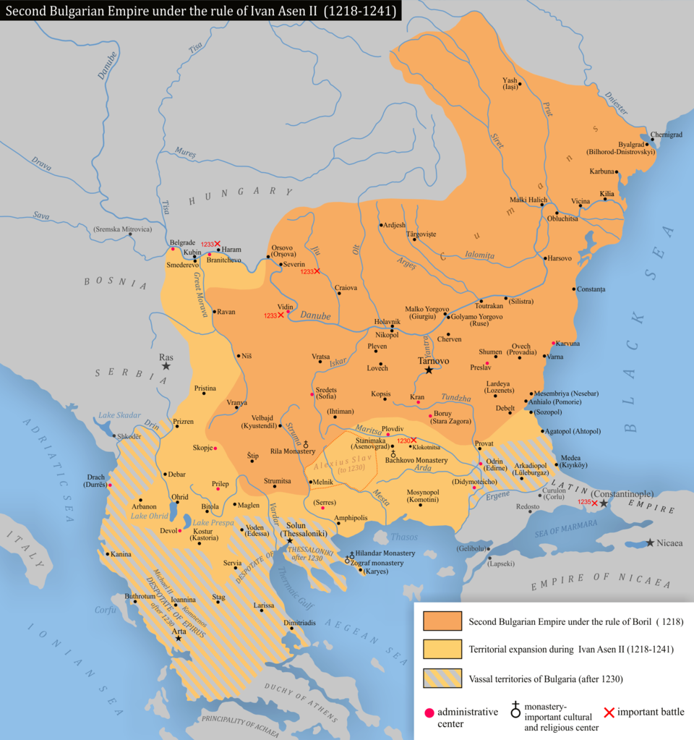
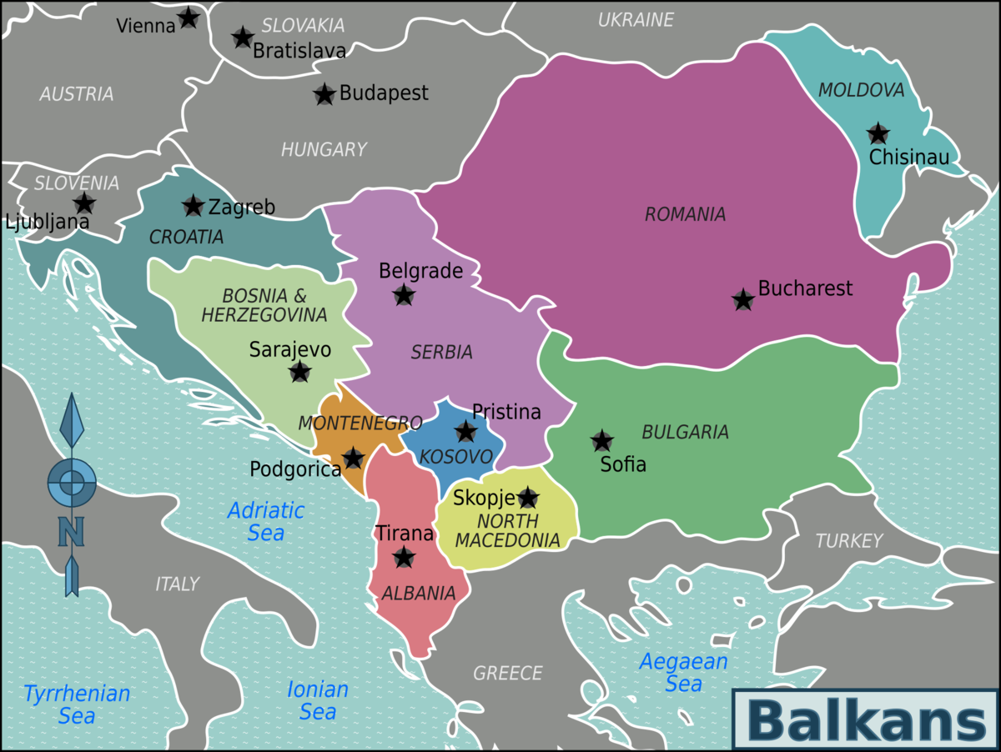
Modern Vs 15 Century Balkans

Slide 5
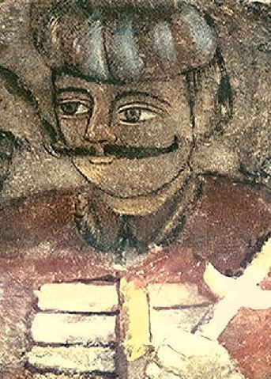

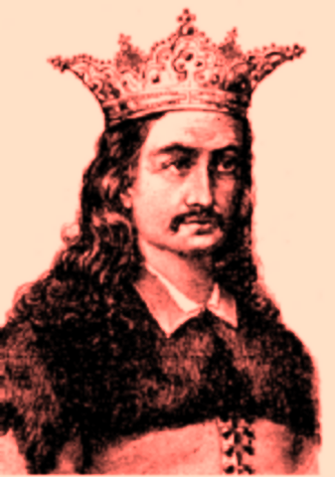
House of Drăculești Rulers
1436
1442
1448
1462
Vlad II Dracul
(Vlad the Dragon)
Mircea II
Vlad III Draculea
(Vlad The Impaler)
Radu cel Frumos
(Radu the Handsome)

Slide 6
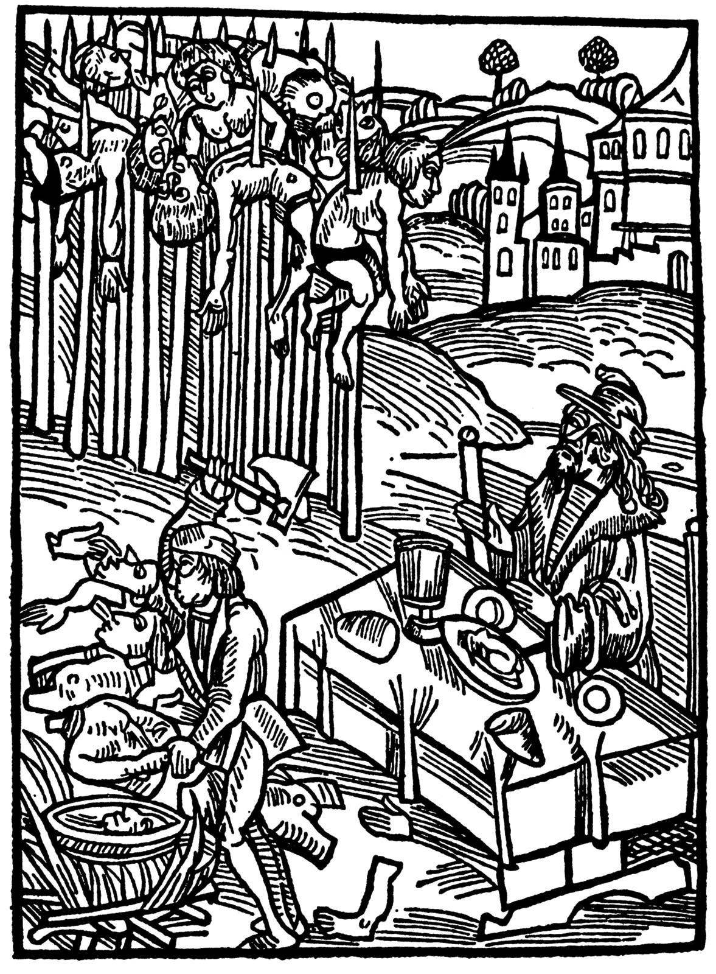
How did Vlad get his infamous epithet?
Vlad’s notorious epithet comes from his cruel punishment methods from his enemies. He inflicted these forms of torture on both foreign and domestic enemies. Vlad would often watch his victims for a prolonged amount of time after placing them on giant wooden spikes, giving him the epithet, “The Impaler.”

Slide 7
Moving Into Modern Day Adaptations

Slide 8
Film & Book Adaptations

Slide 9
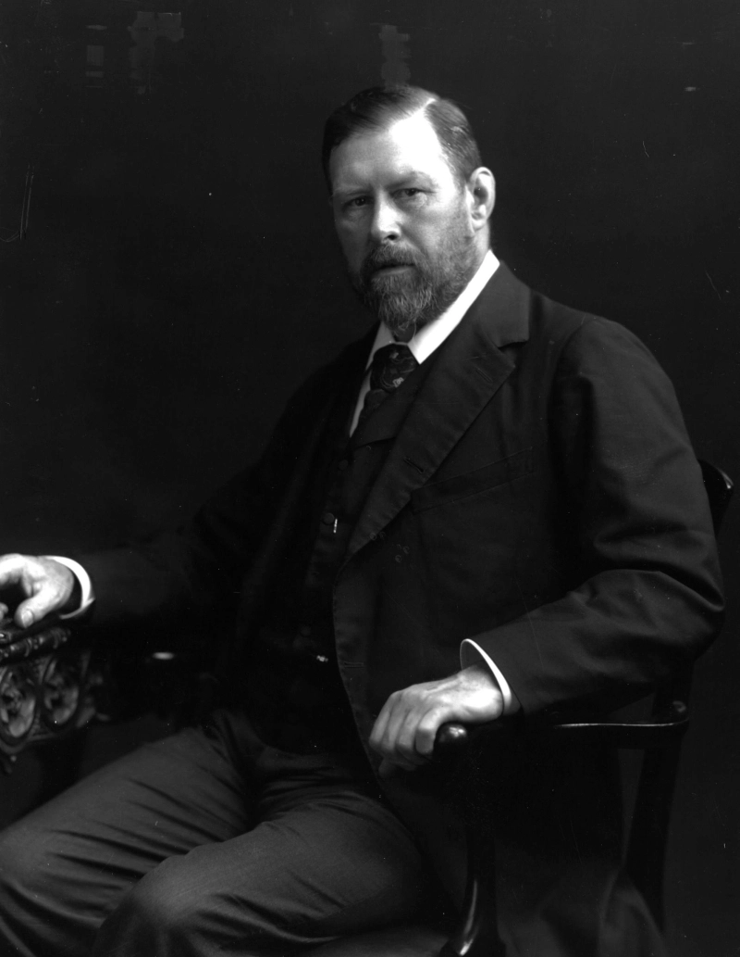
Bram Stoker’s Dracula
The first modern adaptation of Dracula began with Stoker’s novel Dracula. In this novel, there is as nobleman named Count Dracula who has supernatural powers and diabolical ambitions. The setting of the novel was also in Vlad’s Castle in Transylvania, Bran Castle.

Slide 10

Nosferatu
One of the first movie adaptations of Bram Stoker’s Dracula. In this silent horror expressionist film made in Germany 1922. In this adaptation, a man is sent to Transylvania by his employer who happens to be the vampyre. Once the protagonist cuts his finger, the vampyre runs to suck the blood from his finger.

Slide 11
Video Game Adaptations

Slide 12
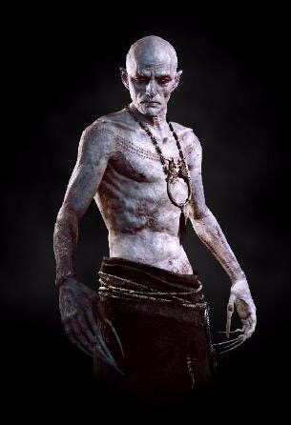
The Witcher 3:
Blood and Wine
In the Witcher 3, vampires are depicted as the dark-loving, bloodthirsty beings that are nearly immortal. Canonically, these vampires are of a separate species than humans that just strive to live in peace, however, humans have found out that their body parts sell for a hefty sum.

Slide 13
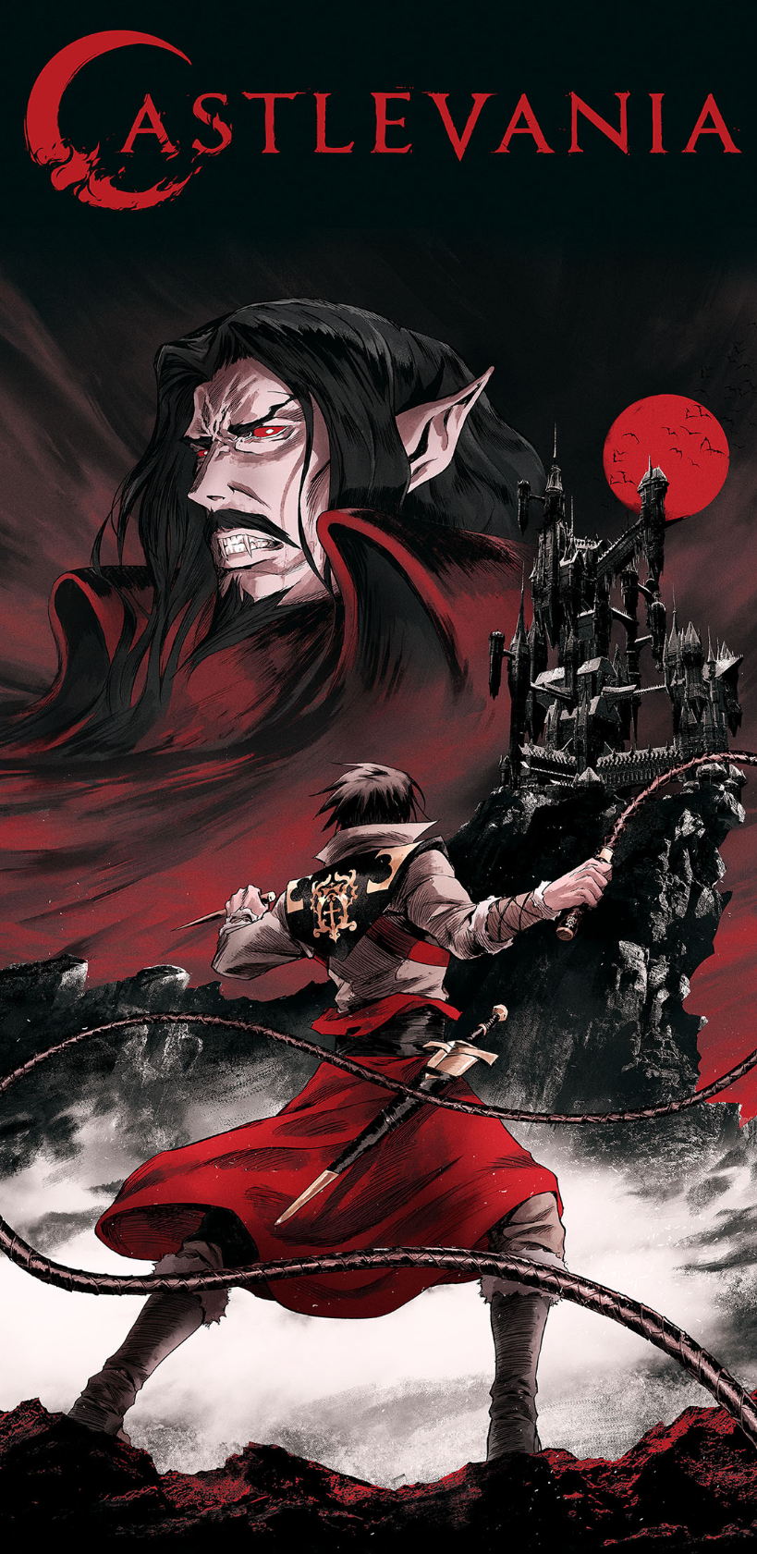
CastleVania
This was a game released in 2003 published by Konami. Here, vampires are constantly being hunted by a clan of vampire hunters. Each hundred years, the Count Dracula revives himself and wrecks havoc on any town in the near vicinity. Evil individuals conduct a black mass to fully resurrect the Count Dracula.

Slide 14
TV Show Adaptations

Slide 15

Hellsing
Hellsing describes vampires as bloodthirsty killers that are commanded by the lead vampire. The vampires would hunt the oblivious human population and the only thing to stop them is the the Hellsing task force who relies on an unlikely recruit, ancient vampire Alucard.

Slide 16

JoJo’s Bizarre Adventure
As a popular manga which has moved past the vampiric theme. The first chapters and episodes relied on a stone mask which can turn people into vampires. Here they are again, fueled by a thirst for blood, and supernatural strengths. However, they retain a weakness to sunlight, which will completely disintegrate.

Slide 17
How does this all relate?

Slide 18
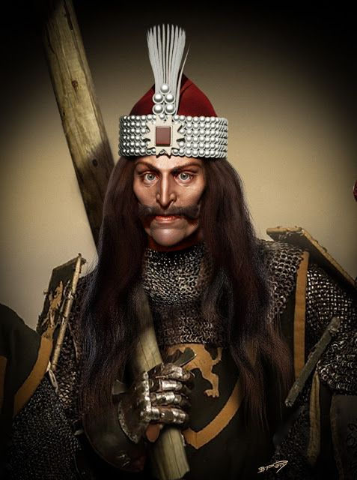
Although we have seen various forms of vampires, all of these versions of vampires have all started because of one single bloodthirsty ruler. There were people who made more literal adaptations, such as Bram Stoker and Nosferatu. There were also people who have made more bizarre adaptations, such as Hellsing and The Witcher. Vlad Draculea’s impact has shaped these characters to be the signature status that anyone can recognize.

Slide 19
Bibliography
“House of Drăculești.” Hyperleap, hyperleap.com/topic/House_of_Dr%C4%83cule%C8%99ti.
O’Hara, Leonie. “How Bram Stoker Created Dracula with the Aid of Irish Folklore.” IrishCentral.com, IrishCentral, 4 Nov. 2020, www.irishcentral.com/roots/history/dracula-bram-stoker-inspiration.
“Vlad the Impaler.” Encyclopædia Britannica, Encyclopædia Britannica, Inc., www.britannica.com/biography/Vlad-the-Impaler.

Slide 20
Bibliography continued
“Dracula Legend.” Count Dracula's Legend and the History of Vlad the Impaler, romaniatourism.com/dracula-legend.html.
Stoker, Dacre, and J.D. Barker. “The Real History That Went Into Bram Stoker's Dracula.” Time, Time, 25 Feb. 2019, time.com/5411826/bram-stoker-dracula-history/.
“Hellsing.” IMDb, IMDb.com, 10 Oct. 2001, www.imdb.com/title/tt0325547/?ref_=vp_back.
Vlad the IMPALER Timeline. 1 Dec. 1431, www.timetoast.com/timelines/vlad-the-impaler--5.

